Slide 1
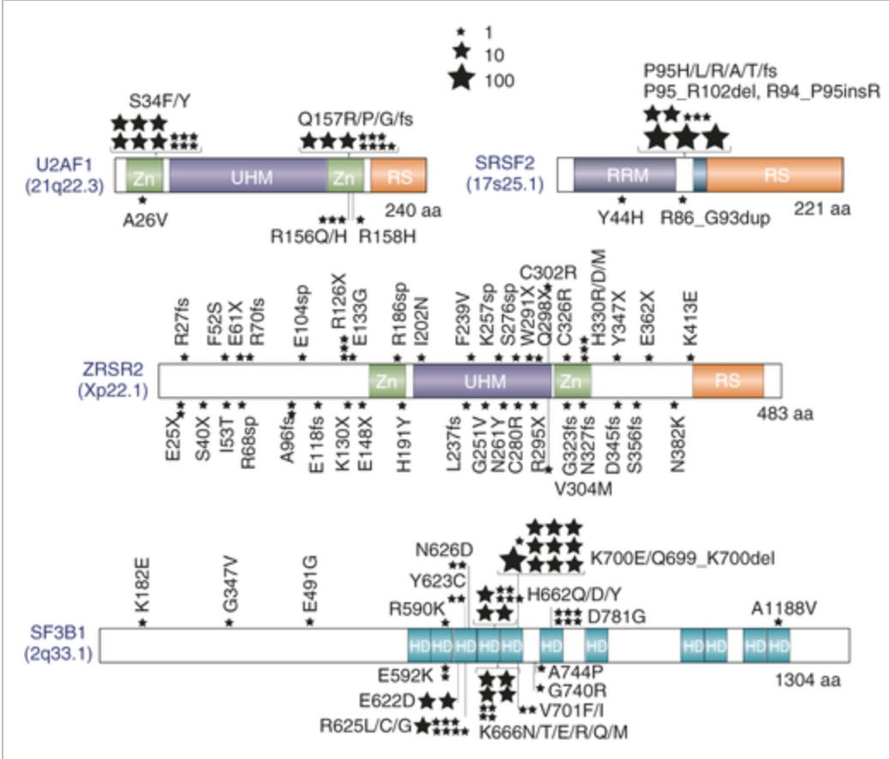
Core components of spliceosome are targeted by many cancer-derived mutations
Among them, SF3B1 is the most frequently mutated spliceosomal protein and thus a major drug target for therapy.

Slide 2
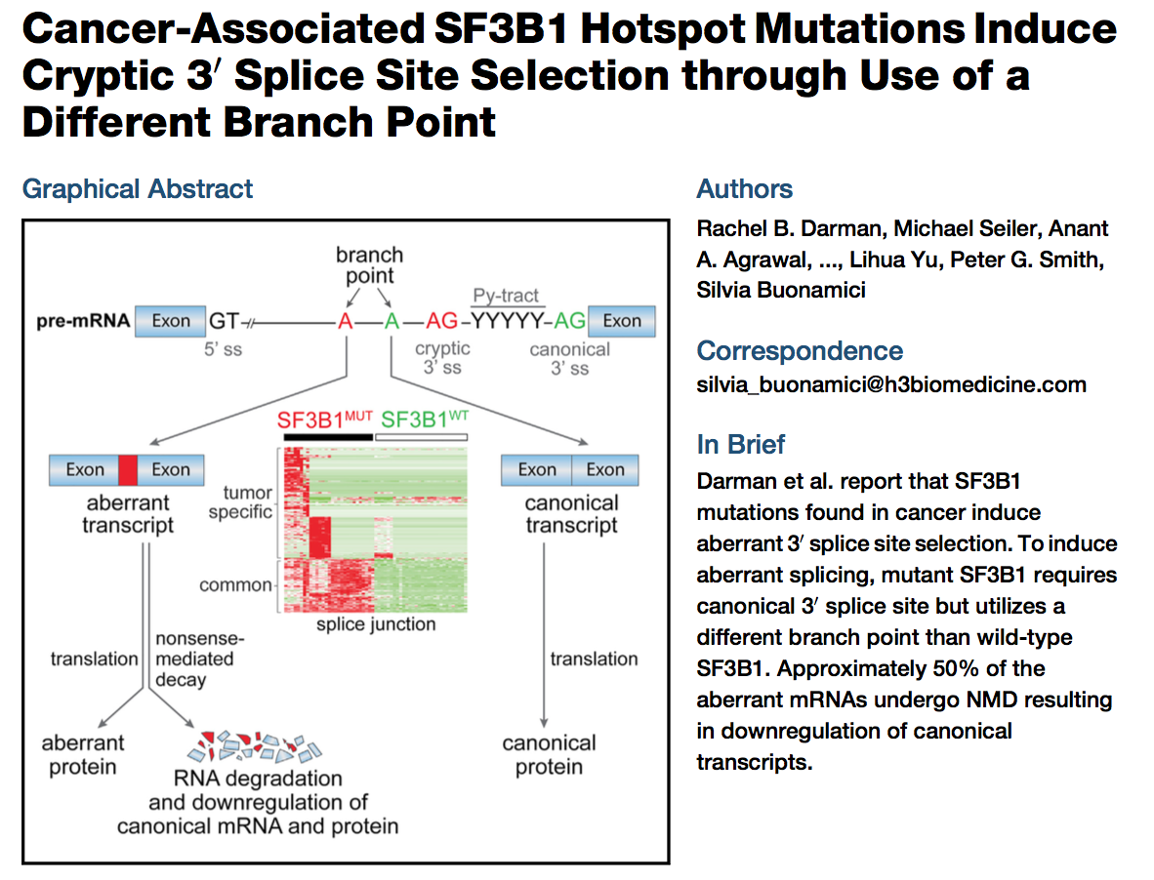

SF3B1 mutations led to dysregulated RNA splicing

Slide 3
What’s the underlying mechanism?

Slide 4
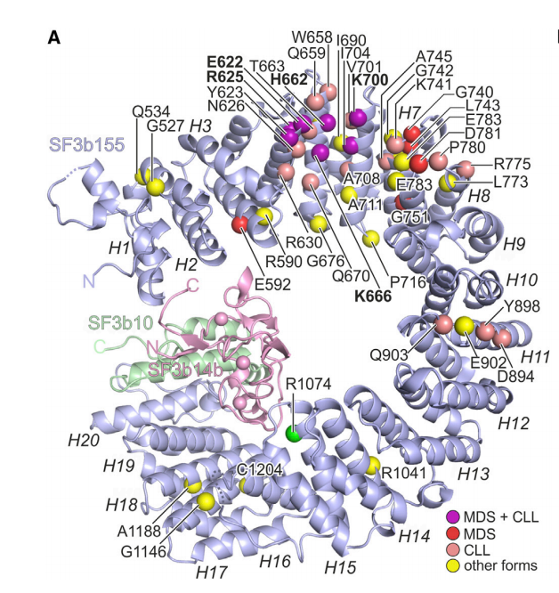
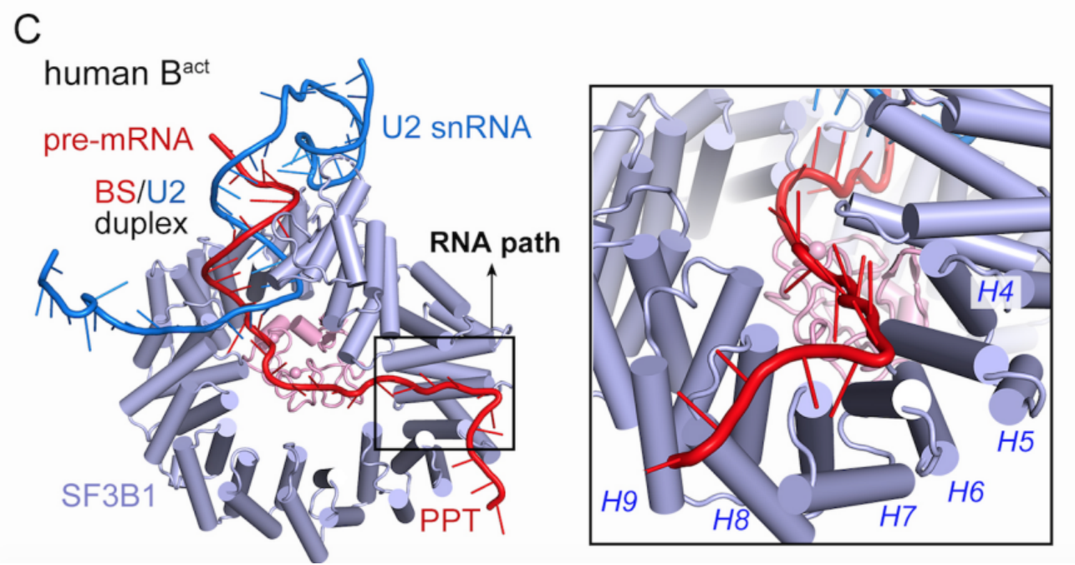
Cancer-driving mutations of SF3B1 are clustered in the RNA path
The RNA path is the SF3B1 pre-mRNA binding path, which is identified in the structure of human spliceosome
SF3B1 RNA path
Structure of SF3B1 (also known as SF3b155)

Slide 5
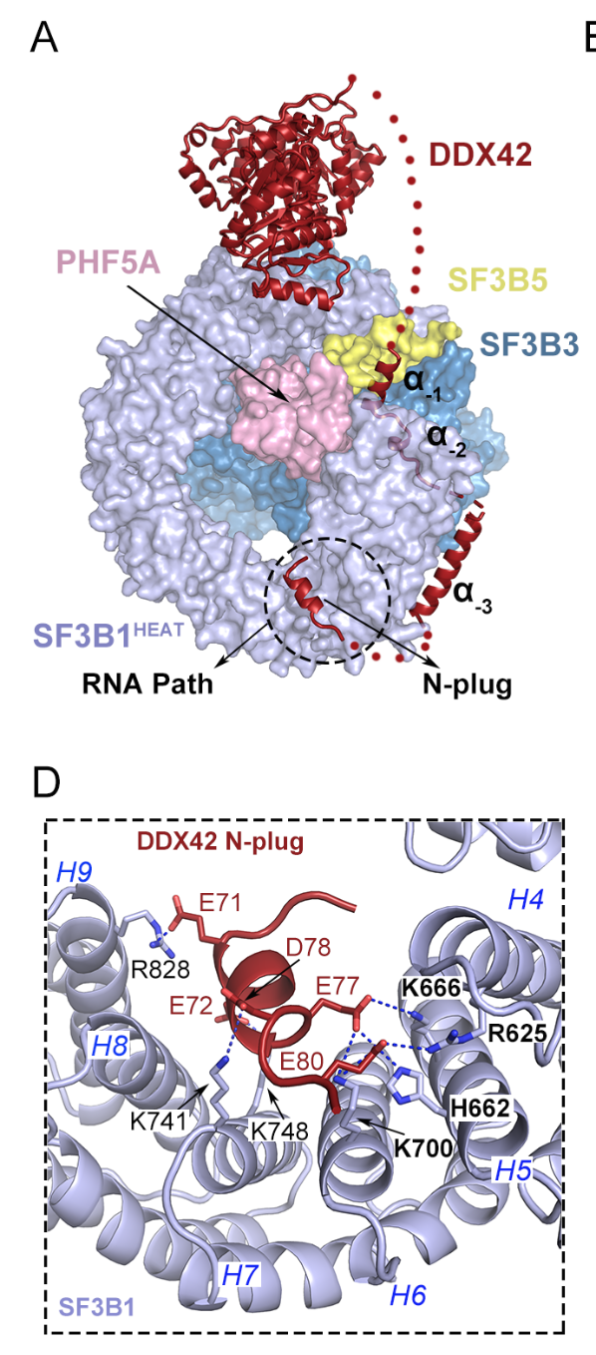
In this study, we identified two new proteins binding at the RNA path of SF3B1
Protein 1:
These residues are frequently mutated in cancer: R625, H662, K666, K700, K741

Slide 6
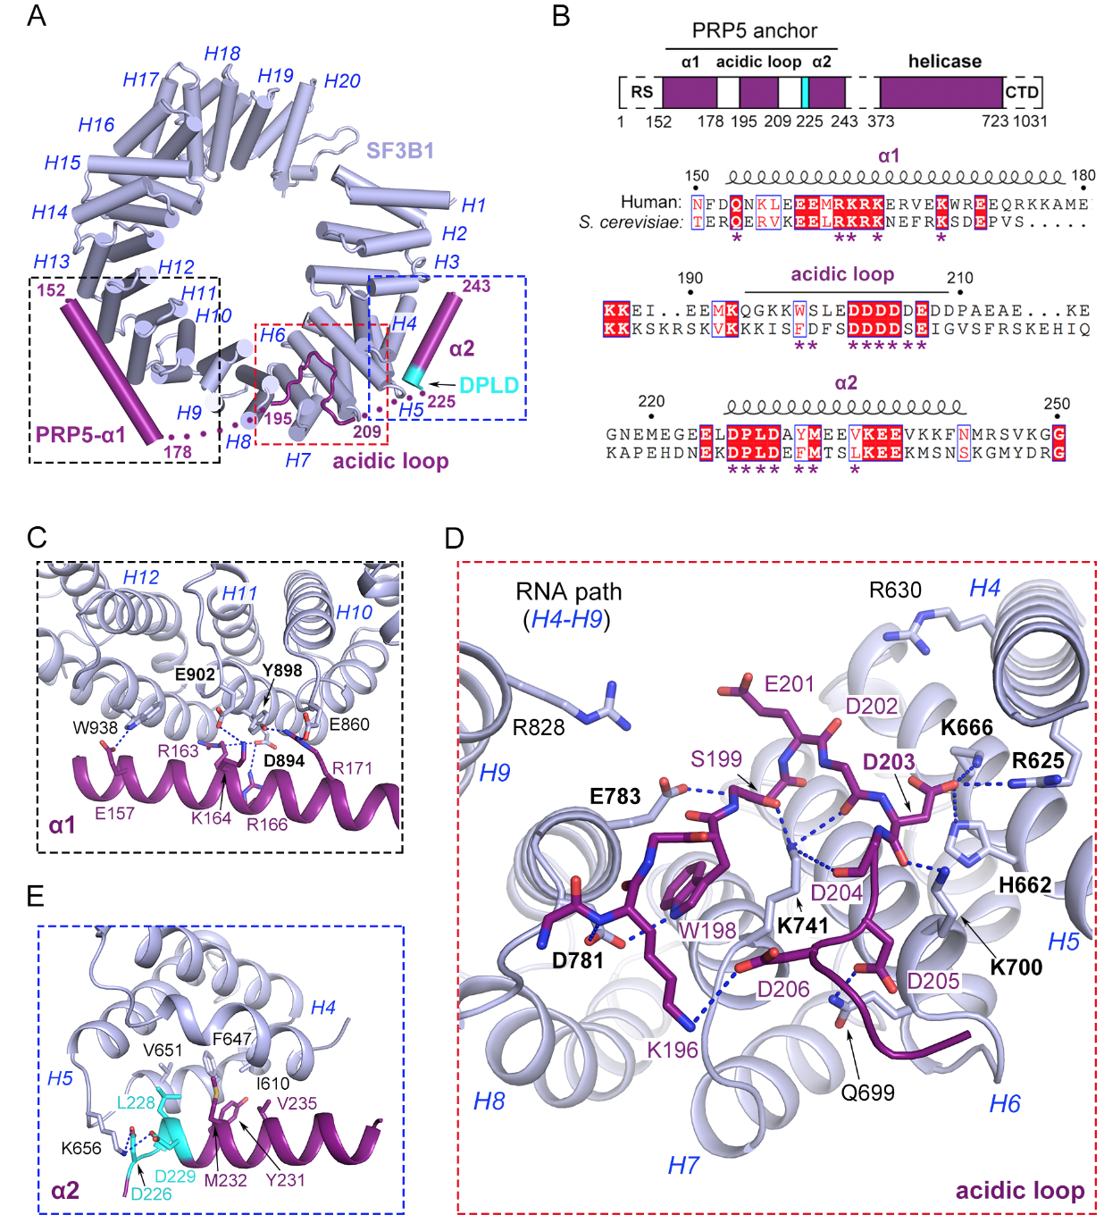
Protein 2:
These residues are frequently mutated in cancer: R625, H662, K666, K700, K741, D781, E783, D894, Y898, E902

Slide 7
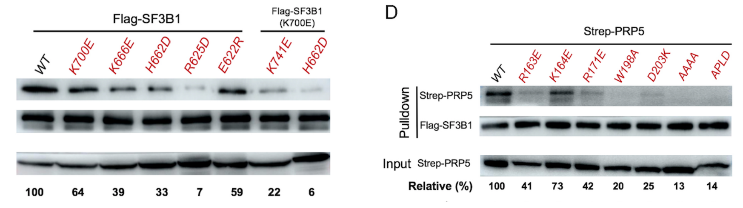
Mutation study：
Cancer mutations of impair SF3B1-PRP5 binding.

Slide 8
In yeast, PRP5 is reported to be responsible for regulating splicing fidelity by proofreading the splicing sites.
Given our structural observation, we propose that mutations targeting SF3B1 RNA path led to crippled PRP5 binding, and consequently are responsible for splicing dysregulation as observed in cancer cells.
To test this hypothesis, we performed RNA-seq experiment to verify if PRP5 mutations phenocopy SF3B1 mutations, and if over-expression of wildtype (WT) PRP5 could rescue the splicing defects caused by SF3B1 mutation.

Slide 9
The experiment was done by transfecting HEK293T cell with:
empty vector control
WT SF3B1
SF3B1(K700E)
SF3B1(K700E) and WT PRP5
SF3B1(KR625C)
SF3B1(R625C) and WT PRP5
SF3B1(H662D)
SF3B1(H662D) and WT PRP5
WT PRP5
PRP5(W198A)
PRP5(D203K)
PRP5(DPLD to AAAA)
36h after transfection, cells were collected, lysed with Trizol reagent. RNAs were extracted and sequenced by Illumina Nova6000 (安诺优达).

Slide 10


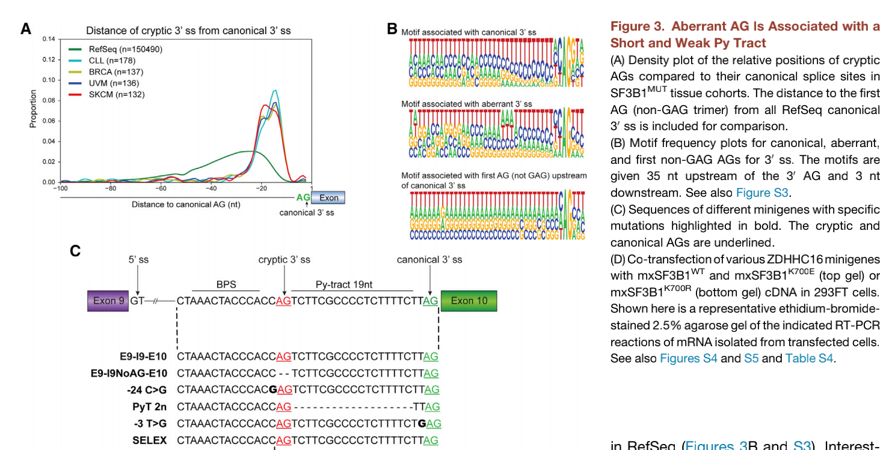
Previously reported phenotypes for SF3B1 mutations:

